Slide 1



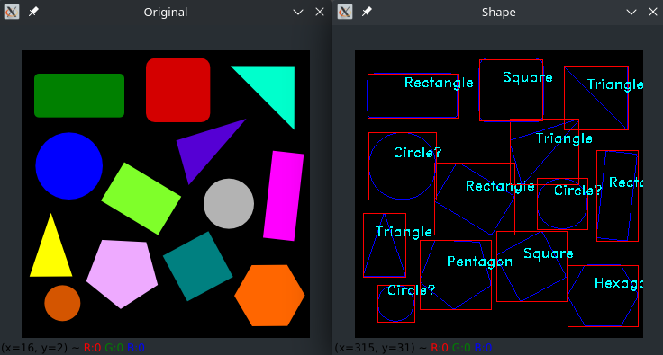
Session 6 :
Introduction to Shape Detection

Slide 2

Introduction
Shape Detection in Computer Vision
- Identifies objects based on their geometric structure.
- Widely used in sorting systems, robotics, and industrial quality control.

Slide 3
Why It Matters
Enables automated classification of objects by shape.
Crucial in robotic vision, manufacturing, and scene understanding.
Reduces human effort in sorting and inspection tasks.

Slide 4
Programming Task
Goal:
Write a script in OpenCV to detect and label common shapes such as:
* Circles
* Rectangles
* Triangles

Slide 5
Real-World Example
Use Case:
A conveyor belt system in a factory that sorts products based on shape.
* Triangle = Hazard signs
* Rectangle = Labels
* Circle = Caps or seals

Slide 6
Skill Gained
Feature extraction using contours
Pattern recognition via shape approximation
Image annotation using cv2.putText

Slide 7
Recognizing Geometric Shapes
Analyze contour properties like:
* Number of sides
* Aspect ratio
* Compactness
Helps classify shapes into standard categories.

Slide 8
Approximating Contours
Use: cv2.approxPolyDP(contour, epsilon, True)
- Simplifies contours into polygons.
- Vertex count is used to identify the shape:
* 3 = Triangle
* 4 = Rectangle
* >5 = Circle or ellipse

Slide 9
Labeling Detected Shapes
Use cv2.putText() to display shape names on the image.
- Labels are placed near shape centroids.
- Improves interpretability for visual inspection.

Slide 10
Preprocessing for Shape Detection
Steps before detection:
- Convert to grayscale
- Apply thresholding
- Use contour detection
Clean binary images ensure accurate results.

Slide 11
Handling Complex Images
In cluttered scenes:
- Filter contours by area
- Use hierarchy levels to ignore nested/noisy shapes
Ensures only the most relevant shapes are detected and labeled.

Slide 12
Python Code :
Shape Detection
Advanced Shape Recognition with Polygon Approximation

Slide 13
Objective & Overview
Objective:
- Detect and classify shapes (triangle, rectangle, circle)
- Use polygon approximation for accurate labeling
Overview:
- Image preprocessing
- Contour detection
- Polygon approximation
- Shape classification
- Annotation and visualization

Slide 14
Step-by-Step Process
Preprocessing:
- Load image using cv2.imread
- Convert to grayscale (cv2.cvtColor)
- Apply binary thresholding (cv2.threshold)
Contour Detection:
- Use cv2.findContours with cv2.RETR_EXTERNAL

Slide 15
Shape Analysis and Classification
Polygon Approximation:
- Approximate contours using cv2.approxPolyDP
- Epsilon = 1% of perimeter
Shape Classification:
- 3 vertices → Triangle
- 4 vertices → Rectangle
- >8 vertices → Ellipse fit (cv2.fitEllipse)
- Aspect ratio ≈ 1 → Circle
- Else → Polygon
Centroid Calculation:
- Use cv2.moments for label placement

Slide 16
Annotation and Display
Annotation:
- Draw contours with cv2.drawContours (red, thickness=2)
- Label shapes using cv2.putText
Display:
- Show result with cv2.imshow()
- Exit loop with 'q' key

Slide 17
Python Code Summary
Highlights:
- cv2.approxPolyDP for polygon approximation
- Conditional logic for shape classification
- Ellipse fitting with cv2.fitEllipse
- Centroid calculation with cv2.moments
- Labeling using cv2.putText

Slide 18

Python Script on Shape Detection
PART 1
import cv2
import numpy as np
# Load image
image = cv2.imread('shapes.jpg')
if image is None:
raise ValueError("Image not found!")
# Convert to grayscale
gray = cv2.cvtColor(image, cv2.COLOR_BGR2GRAY)
# Threshold (invert if shapes are black)
_, binary = cv2.threshold(gray, 127, 255, cv2.THRESH_BINARY)
# Find all contours (not just external)
contours, _ = cv2.findContours(binary, cv2.RETR_TREE, cv2.CHAIN_APPROX_SIMPLE)

Slide 19
Python Script on Shape Detection
PART 2
# Loop through all contours
for contour in contours:
area = cv2.contourArea(contour)
if area < 100: # skip small noise
continue
# Approximate contour
epsilon = 0.01 * cv2.arcLength(contour, True)
approx = cv2.approxPolyDP(contour, epsilon, True)
M = cv2.moments(contour)
cx = int(M['m10'] / M['m00']) if M['m00'] != 0 else 0
cy = int(M['m01'] / M['m00']) if M['m00'] != 0 else 0
shape = "Unknown"
if len(approx) == 3:
shape = "Triangle"
elif len(approx) == 4:

Slide 20
Python Script on Shape Detection
PART 3
x, y, w, h = cv2.boundingRect(approx)
aspect_ratio = float(w) / h
if 0.95 <= aspect_ratio <= 1.05:
shape = "Square"
else:
shape = "Rectangle"
elif len(approx) > 4 and len(approx) <= 8:
shape = "Polygon"
else:
# Check circularity
perimeter = cv2.arcLength(contour, True)
if perimeter == 0:
continue
circularity = 4 * np.pi * area / (perimeter * perimeter)
if circularity > 0.8:
shape = "Circle"
else:
shape = "Polygon"

Slide 21
Python Script on Shape Detection
PART 4
# Draw contour and label
cv2.putText(image, shape, (cx - 30, cy), cv2.FONT_HERSHEY_SIMPLEX, 0.6, (0, 0, 0), 3)
cv2.putText(image, shape, (cx - 30, cy), cv2.FONT_HERSHEY_SIMPLEX, 0.6, (255, 255, 255), 1)
# Show result
cv2.imshow("Shape Detection", image)
cv2.waitKey(0)
cv2.destroyAllWindows()

Slide 22
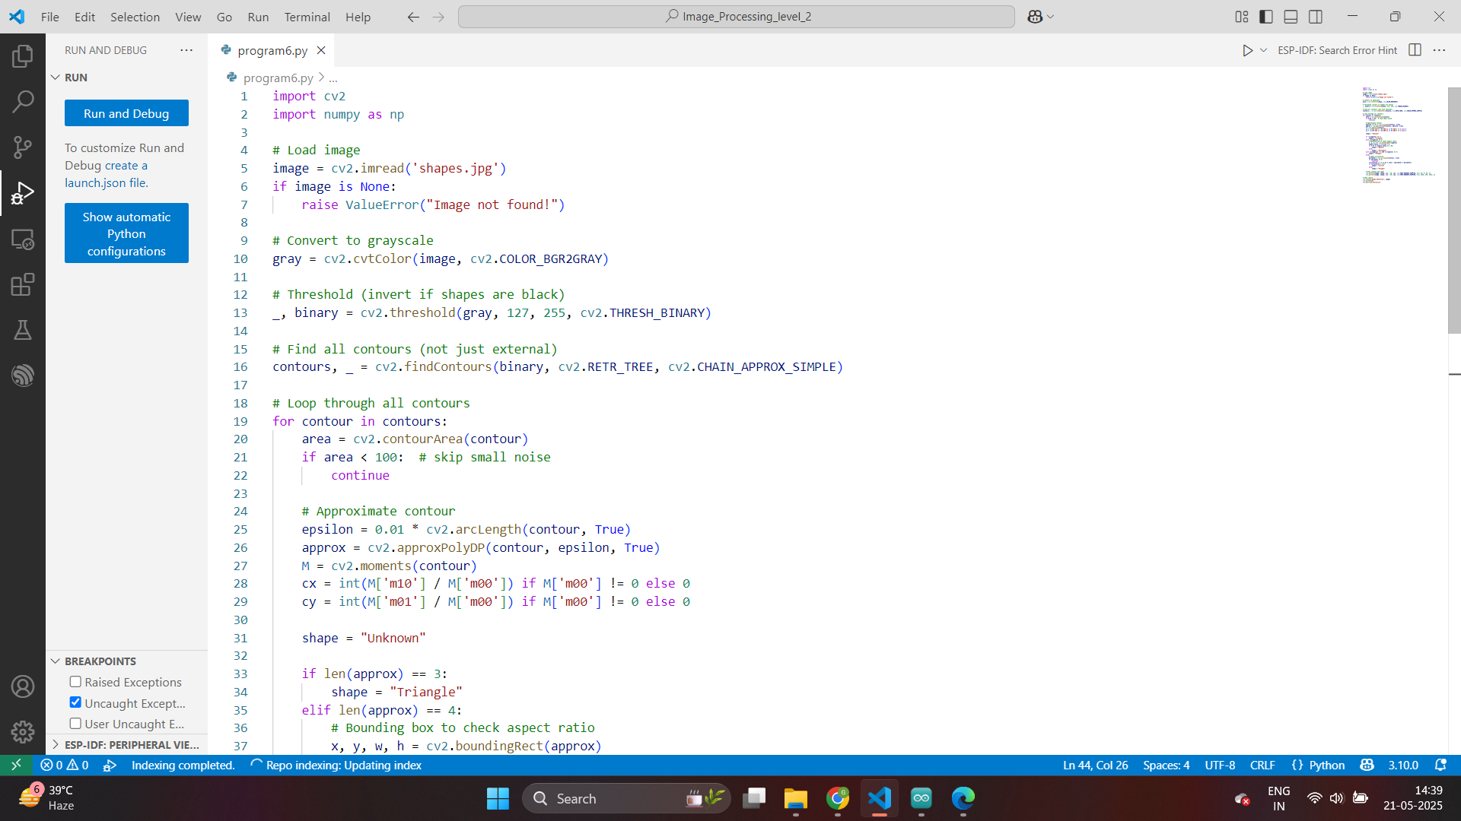

Slide 23


Slide 24
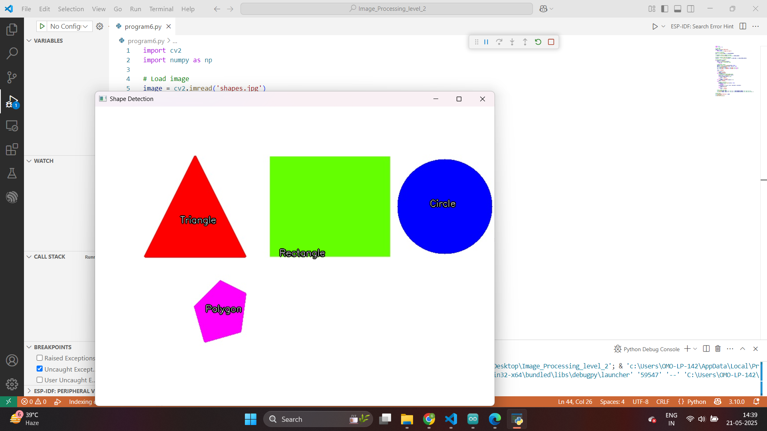

Slide 25
Exercise
1. What is the primary function of shape detection in computer vision?
A. Enhancing image brightness
B. Object classification based on color
C. Identifying objects by geometric structure
D. Image resizing
Answer: C
2. Which OpenCV function is used to simplify contours into polygons?
A. cv2.drawContours
B. cv2.approxPolyDP
C. cv2.contourArea
D. cv2.putText
Answer: B

Slide 26
Exercise
3. If a detected polygon has 3 vertices, what shape is it classified as?
A. Circle
B. Square
C. Triangle
D. Pentagon
Answer: C
4. What image preprocessing steps are essential before detecting shapes?
A. Convert to HSV and apply histogram equalization
B. Resize and rotate
C. Convert to grayscale and apply binary thresholding
D. Flip and crop
Answer: C

Slide 27
Exercise
5. What is used to calculate the centroid of a contour?
A. cv2.boundingRect
B. cv2.arcLength
C. cv2.findContours
D. cv2.moments
Answer: D
6. Which property is used to help classify a shape as a circle when using polygon approximation?
A. The number of edges = 2
B. Aspect ratio is approximately 1
C. Vertices = 4
D. Color of the shape
Answer: B

Slide 28
Exercise
7. What OpenCV function displays text annotations on an image?
A. cv2.putText
B. cv2.drawContours
C. cv2.imshow
D. cv2.threshold
Answer: A
8. Which technique is used to ignore irrelevant or noisy shapes in cluttered images?
A. Convert to RGB
B. Resize image
C. Filter contours by area and use hierarchy
D. Convert to LAB color space
Answer: C

Slide 29
Exercise
9. In the ellipse fitting condition, how many vertices must a contour approximately have?
A. Exactly 5
B. More than 8
C. Less than 4
D. Equal to 2
Answer: B
10. What real-world application is highlighted as a use case for shape detection?
A. Face recognition system
B. Barcode scanning
C. Sorting products on a conveyor belt
D. Weather prediction
Answer: C

